Slide 1

Predicting Customer Behavior for Ad clicks Advertising Data
Data
Modelling
Data
Visualization
Neural
Network
Decision
Tree
Summary Statistics
Naïve
Bayes
ROC
SVM
Introduction
Conclusion
Summary
KNN
Machine learning algorithms

Slide 2
Daily Time Spent on Site - Minutes spent by a visitor on the website
Daily Time Spent on Internet - Minutes spent by a visitor on the internet on a day
Age - Age of the visitor
Area Income - Average income of the visitor based on area
Ad Topic Line - A headline of the advertisement displayed to the visitor
City - City of the visitor
Country - Country of the visitor
Male - Gender of the visitor (Male = 1 and Female = 0)
Timestamp - Time and date at which visitor logged in on the website
Clicked on Ad - Class label if the visitor clicked on the ad or not (Clicked = 1 and Not clicked = 0)
Data
Modelling
Data
Visualization
Neural
Network
Decision
Tree
Summary Statistics
Naïve
Bayes
ROC
SVM
Introduction
Conclusion
Summary
KNN

Slide 3



Predicting Customer Behavior for Ad clicks Advertising Data
Data
Modelling
Data
Visualization
Neural
Network
Decision
Tree
Summary Statistics
Data
Cleaning
Naïve
Bayes
ROC
SVM
Conclusion
Summary
KNN
Step 1
Step 2
Step 3
Machine learning algorithms
COLUMN NAMES
DATA TYPE
COLUMN ORDER
ISO CODE

Slide 4
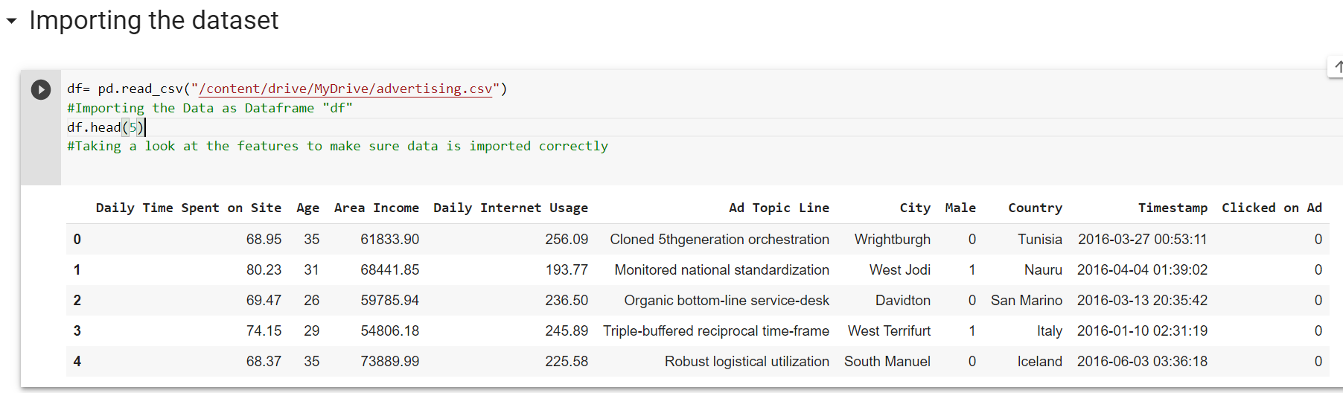
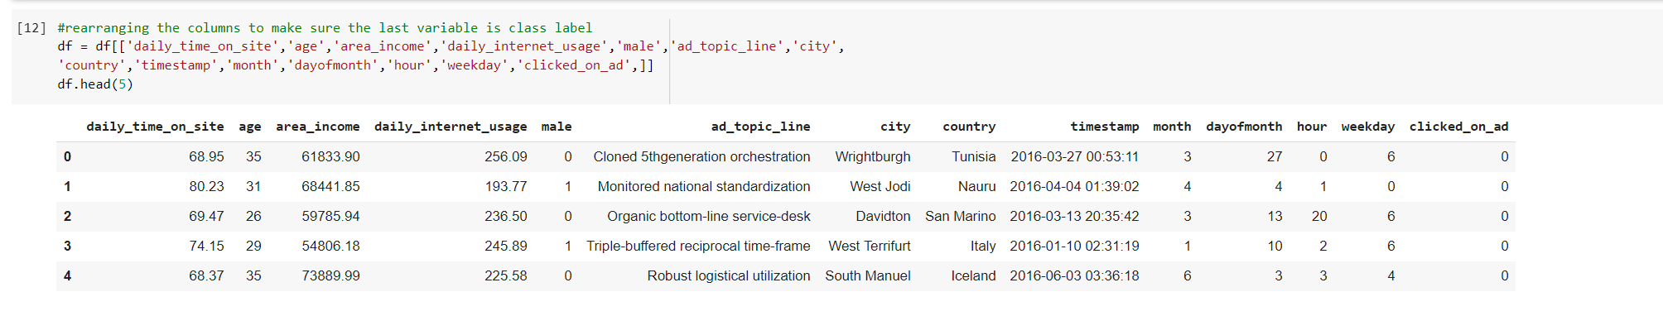
RAW DATA
Data
Modelling
Data
Visualization
Summary Statistics
Neural
Network
Decision
Tree
Data
Cleaning
Naïve
Bayes
ROC
SVM
Conclusion
Summary
KNN
CLEAN DATA

Slide 5
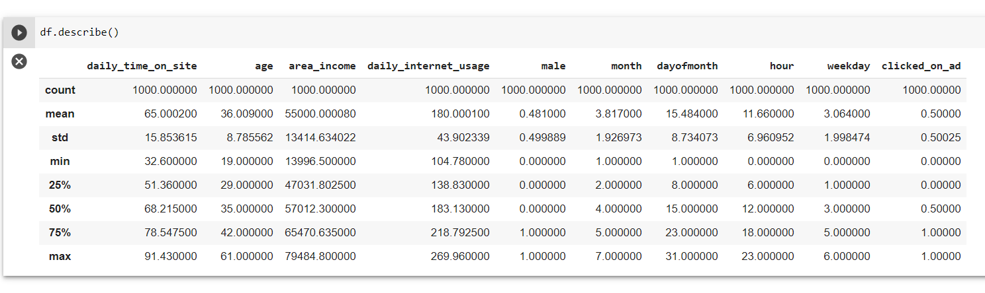
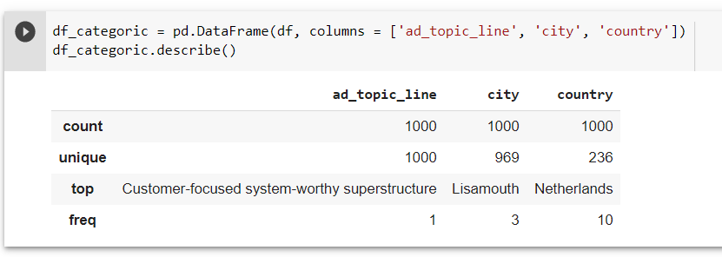
Predicting Customer Behavior for Ad clicks Advertising Data
Data
Modelling
Data
Visualization
Summary Statistics
Neural
Network
Decision
Tree
Data
Cleaning
Naïve
Bayes
ROC
SVM
Conclusion
Summary
KNN
Step 1
Step 2
Step 3
Machine learning algorithms
COLUMN NAMES
DATA TYPE
COLUMN ORDER
ISO CODE

Slide 6
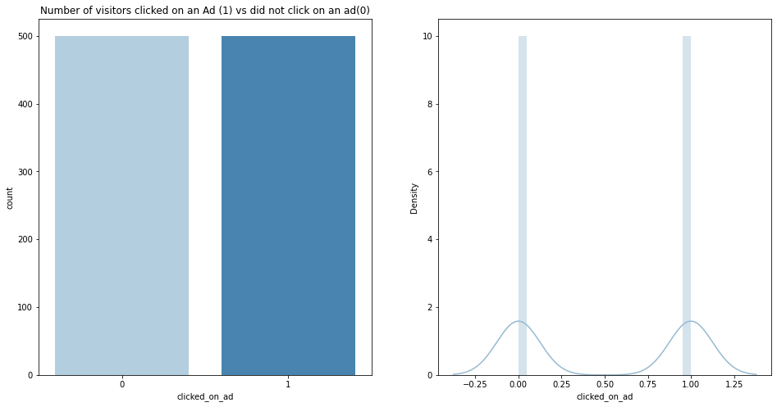
Plot 1: Clicked vs not Clicked
Predicting Customer Behavior for Ad clicks Advertising Data
Data
Modelling
Data
Visualization
Summary Statistics
Neural
Network
Decision
Tree
Data
Cleaning
Naïve
Bayes
ROC
SVM
Conclusion
Summary
KNN
Step 1
Step 2
Step 3
Machine learning algorithms
COLUMN NAMES
DATA TYPE
COLUMN ORDER
ISO CODE

Slide 7
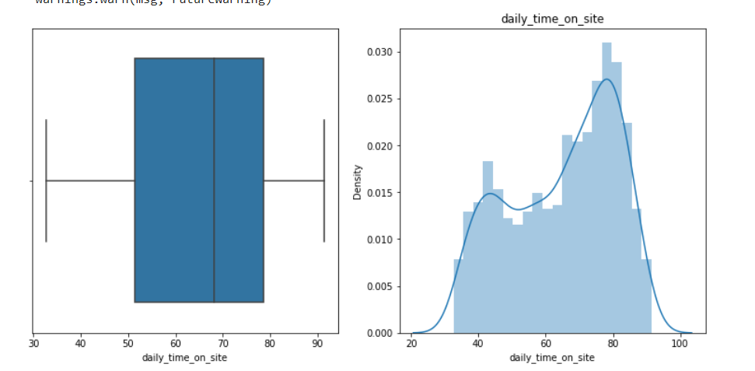
Plot 2: Daily Time on Site
Predicting Customer Behavior for Ad clicks Advertising Data
Data
Modelling
Data
Visualization
Summary Statistics
Neural
Network
Decision
Tree
Data
Cleaning
Naïve
Bayes
ROC
SVM
Conclusion
Summary
KNN
Step 1
Step 2
Step 3
Machine learning algorithms
COLUMN NAMES
DATA TYPE
COLUMN ORDER
ISO CODE

Slide 8
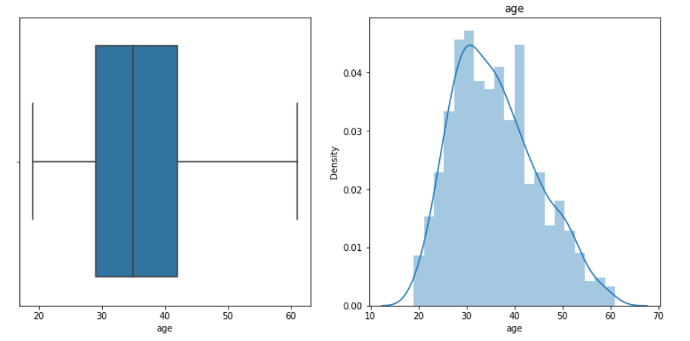
Plot 2: Age
Predicting Customer Behavior for Ad clicks Advertising Data
Data
Modelling
Summary Statistics
Data
Visualization
Neural
Network
Decision
Tree
Data
Cleaning
Naïve
Bayes
ROC
SVM
Conclusion
Summary
KNN
Step 1
Step 2
Step 3
Machine learning algorithms
COLUMN NAMES
DATA TYPE
COLUMN ORDER
ISO CODE

Slide 9
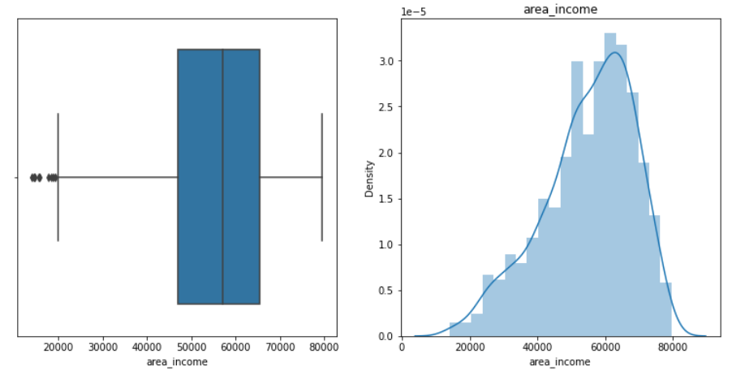
Plot 2: Area Income
Predicting Customer Behavior for Ad clicks Advertising Data
Data
Modelling
Data
Visualization
Summary Statistics
Neural
Network
Decision
Tree
Data
Cleaning
Naïve
Bayes
ROC
SVM
Conclusion
Summary
KNN
Step 1
Step 2
Step 3
Machine learning algorithms
COLUMN NAMES
DATA TYPE
COLUMN ORDER
ISO CODE

Slide 10
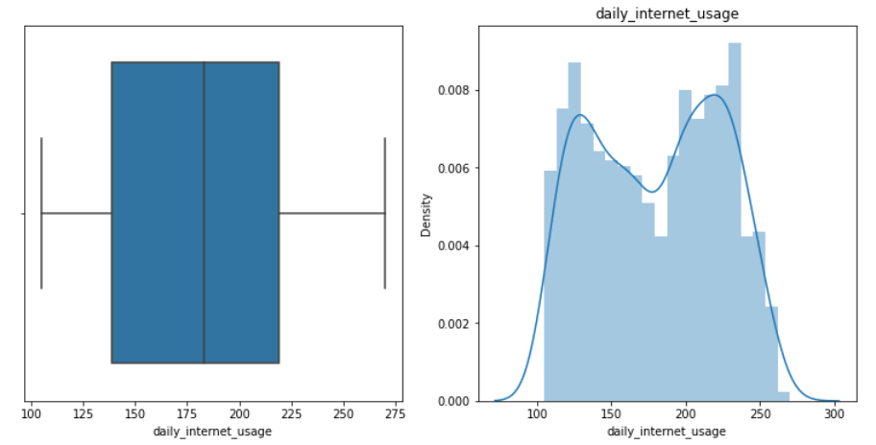
Plot 2: Daily Internet Usage
Predicting Customer Behavior for Ad clicks Advertising Data
Data
Modelling
Data
Visualization
Summary Statistics
Neural
Network
Decision
Tree
Data
Cleaning
Naïve
Bayes
ROC
SVM
Conclusion
Summary
KNN
Step 1
Step 2
Step 3
Machine learning algorithms
COLUMN NAMES
DATA TYPE
COLUMN ORDER
ISO CODE

Slide 11
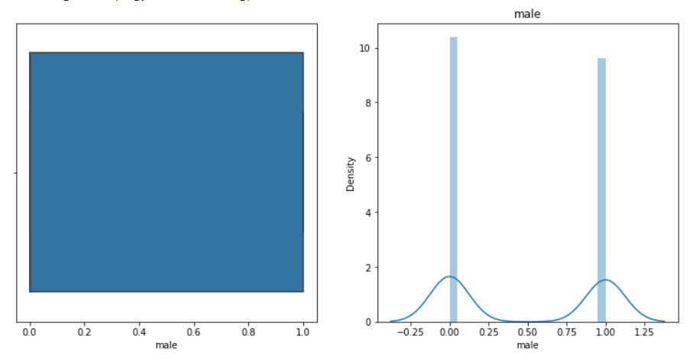
Plot 2: Gender
Predicting Customer Behavior for Ad clicks Advertising Data
Data
Modelling
Data
Visualization
Summary Statistics
Neural
Network
Decision
Tree
Data
Cleaning
Naïve
Bayes
ROC
SVM
Conclusion
Summary
KNN
Step 1
Step 2
Step 3
Machine learning algorithms
COLUMN NAMES
DATA TYPE
COLUMN ORDER
ISO CODE

Slide 12
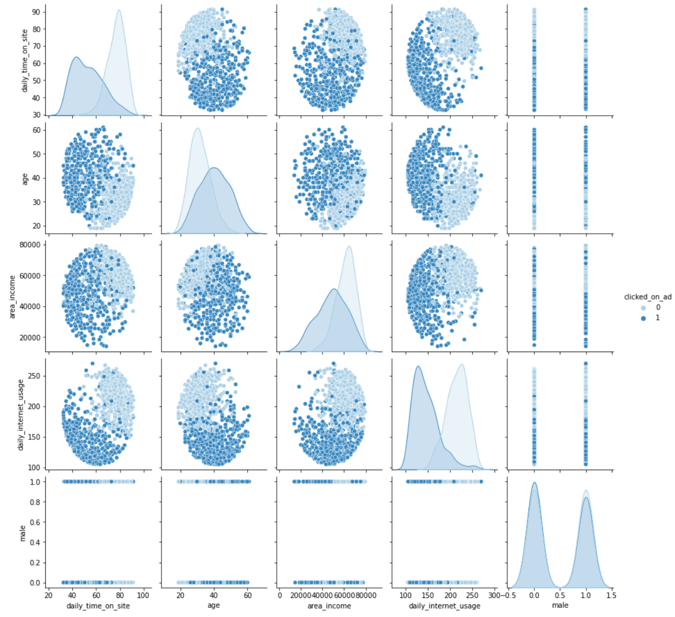
Plot 3: Pair Plot
Predicting Customer Behavior for Ad clicks Advertising Data
Data
Modelling
Data
Visualization
Summary Statistics
Neural
Network
Decision
Tree
Data
Cleaning
Naïve
Bayes
ROC
SVM
Conclusion
Summary
KNN
Step 1
Step 2
Step 3
Machine learning algorithms
COLUMN NAMES
DATA TYPE
COLUMN ORDER
ISO CODE

Slide 13
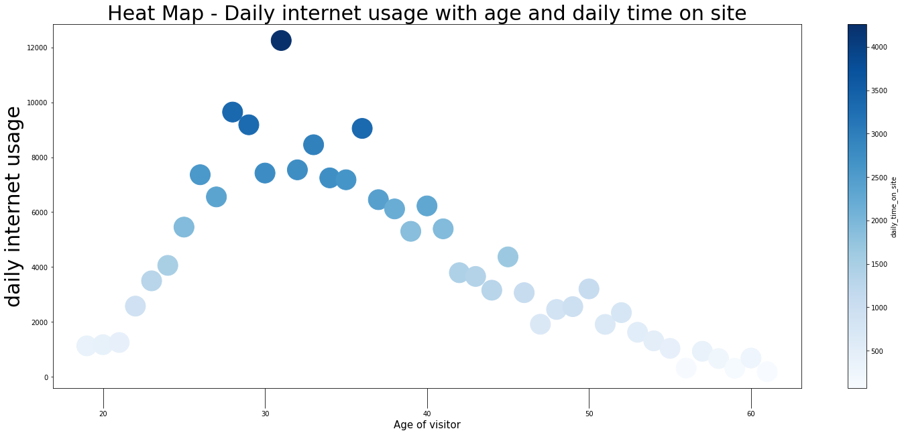
Plot 4: Heat Map
Predicting Customer Behavior for Ad clicks Advertising Data
Data
Modelling
Summary Statistics
Neural
Network
Decision
Tree
Data
Cleaning
Naïve
Bayes
Data
Visualization
ROC
SVM
Conclusion
Summary
KNN
Step 1
Step 2
Step 3
Machine learning algorithms
COLUMN NAMES
DATA TYPE
COLUMN ORDER
ISO CODE

Slide 14
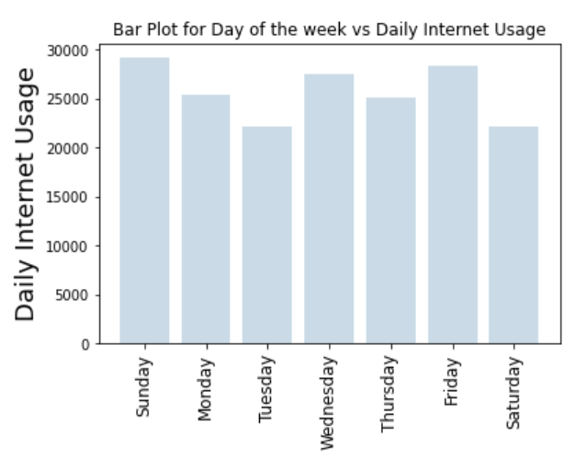
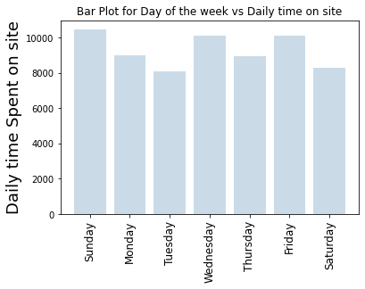
Plot 5: Weekday comparison
Predicting Customer Behavior for Ad clicks Advertising Data
Data
Visualization
Summary Statistics
Neural
Network
Decision
Tree
Data
Cleaning
Naïve
Bayes
Data
Modelling
ROC
SVM
Conclusion
Summary
KNN
Step 1
Step 2
Step 3
Machine learning algorithms
COLUMN NAMES
DATA TYPE
COLUMN ORDER
ISO CODE

Slide 15
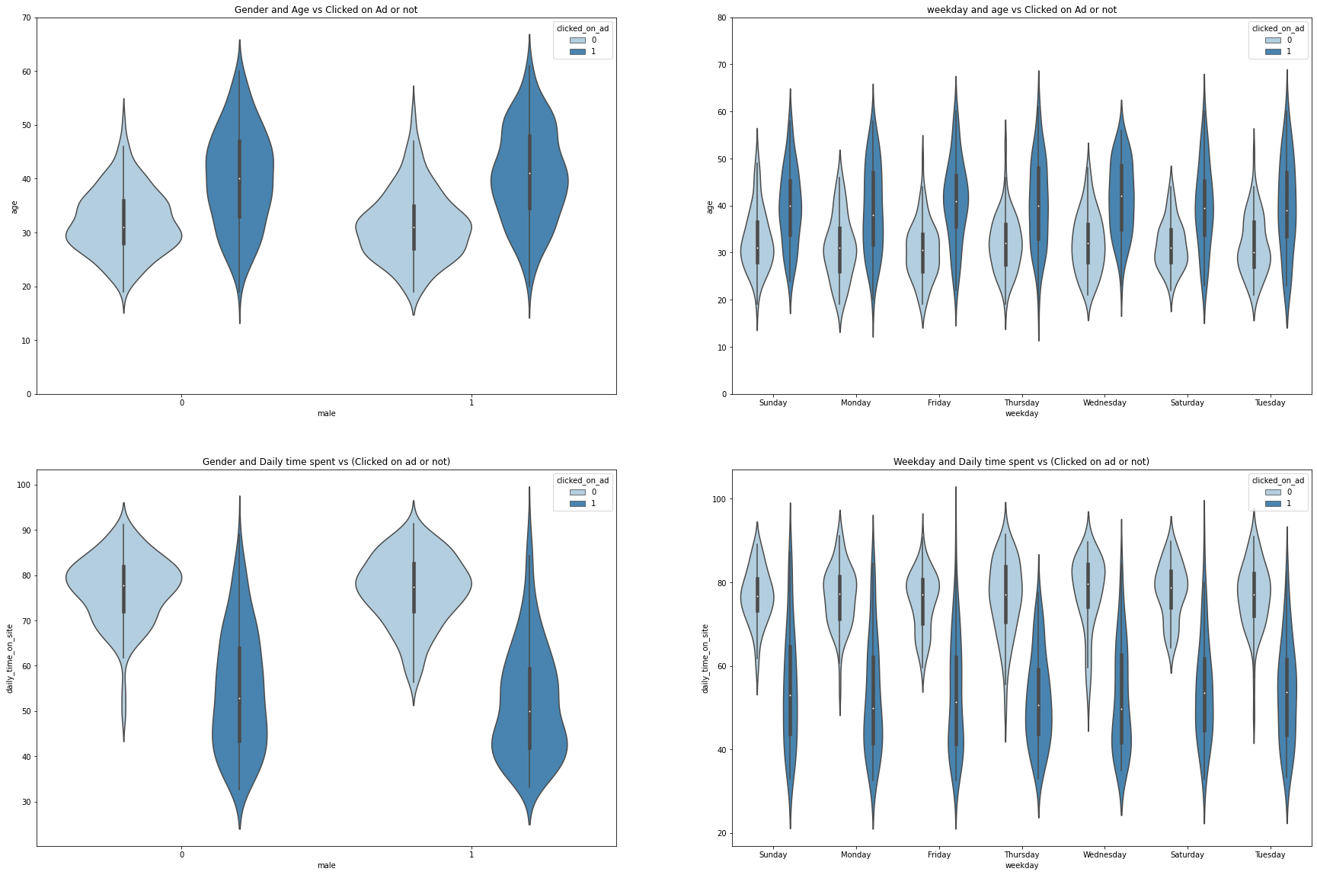
Plot 6: Distribution of data in Gender, Age, Weekday and Time on site
Predicting Customer Behavior for Ad clicks Advertising Data
Data
Modelling
Data
Visualization
Summary Statistics
Neural
Network
Decision
Tree
Data
Cleaning
Naïve
Bayes
ROC
SVM
Conclusion
Summary
KNN
Step 1
Step 2
Step 3
Machine learning algorithms
COLUMN NAMES
DATA TYPE
COLUMN ORDER
ISO CODE

Slide 16
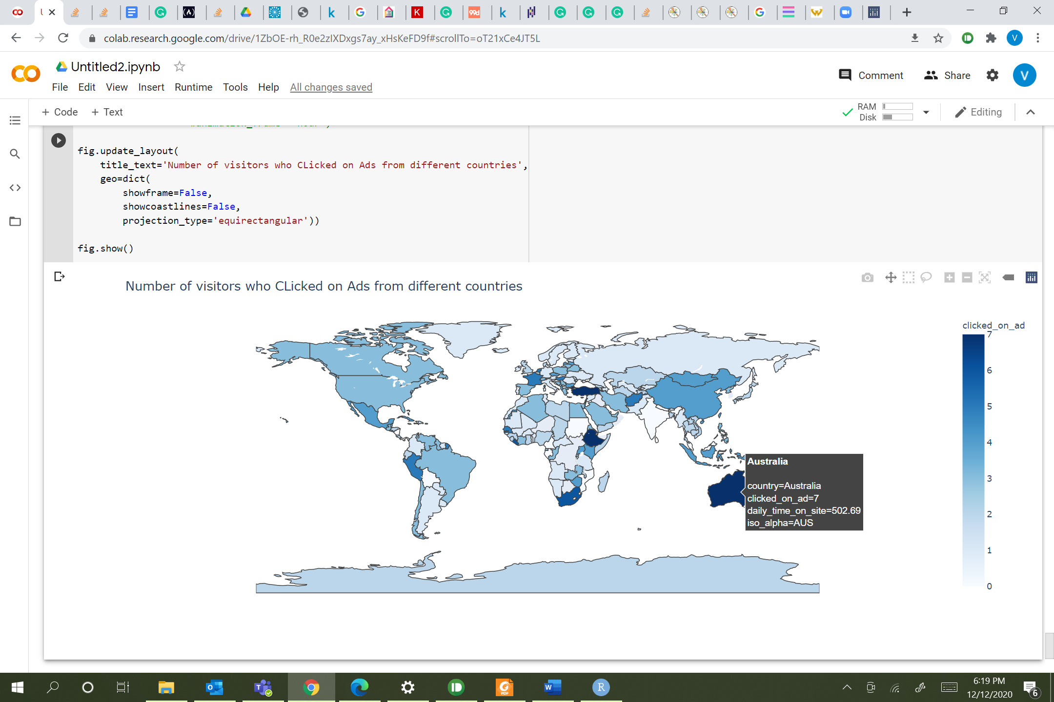
Plot 7: Ad clicks from country
Predicting Customer Behavior for Ad clicks Advertising Data
Data
Modelling
Data
Visualization
Summary Statistics
Neural
Network
Decision
Tree
Data
Cleaning
Naïve
Bayes
ROC
SVM
Conclusion
Summary
KNN
Step 1
Step 2
Step 3
Machine learning algorithms
COLUMN NAMES
DATA TYPE
COLUMN ORDER
ISO CODE

Slide 17
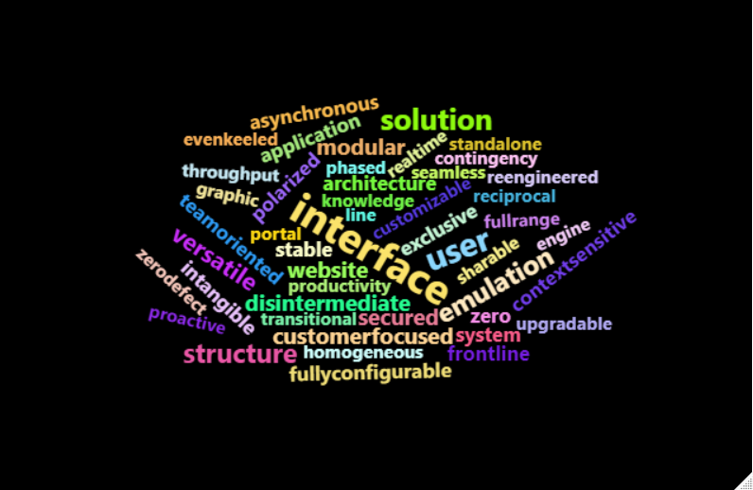
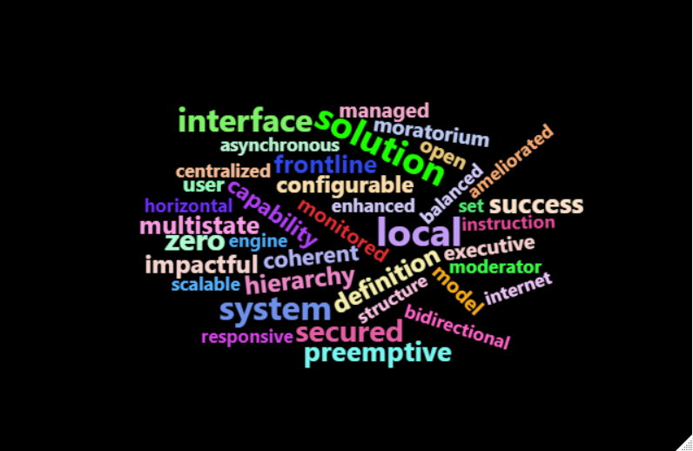
Plot 8: Text Analytics
Most frequent words when Ads not clicked
Most frequent words when Ads clicked
Predicting Customer Behavior for Ad clicks Advertising Data
Data
Modelling
Data
Visualization
Summary Statistics
Neural
Network
Decision
Tree
Data
Cleaning
Naïve
Bayes
ROC
SVM
Conclusion
Summary
KNN
Step 1
Step 2
Step 3
Machine learning algorithms
COLUMN NAMES
DATA TYPE
COLUMN ORDER
ISO CODE

Slide 18
Data splitting
Most frequent words when Ads not clicked
70% TRAINING
30% TEST
Most frequent words when Ads clicked
Predicting Customer Behavior for Ad clicks Advertising Data
LIBRARIES
COLUMNS
Data
Visualization
Data
Modelling
Summary Statistics
Neural
Network
Decision
Tree
Data
Cleaning
Naïve
Bayes
ROC
SVM
Conclusion
Summary
KNN
SPLITING
DATA
Step 1
Step 2
Step 3
Machine learning algorithms
COLUMN NAMES
DATA TYPE
COLUMN ORDER
ISO CODE
SKLEARN
TRAIN_TEST_SPLIT
'daily_time_on_site’,
'age’,
'area_income’,
'daily_internet_usage’,
'male'

Slide 19
Decision Tree
Most frequent words when Ads not clicked
Most frequent words when Ads clicked
Accuracy – 93.66%
Function
Pruned
Depth - 4
Data
Modelling
Data
Visualization
Summary Statistics
Neural
Network
Data
Cleaning
Naïve
Bayes
Decision
Tree
ROC
SVM
Conclusion
Summary
KNN
Unpruned
Default
Step 3
COLUMN ORDER
ISO CODE
Decision Tree Classifier
Accuracy – 94.66%

Slide 20
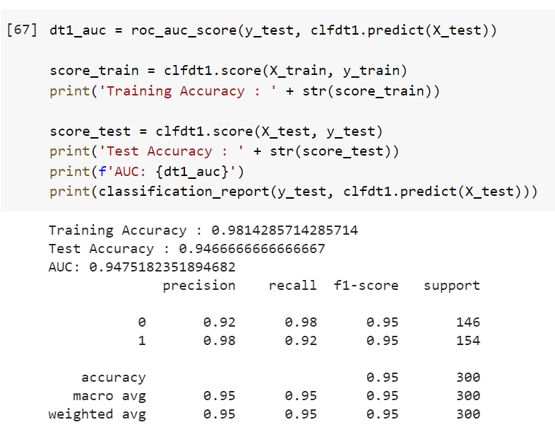
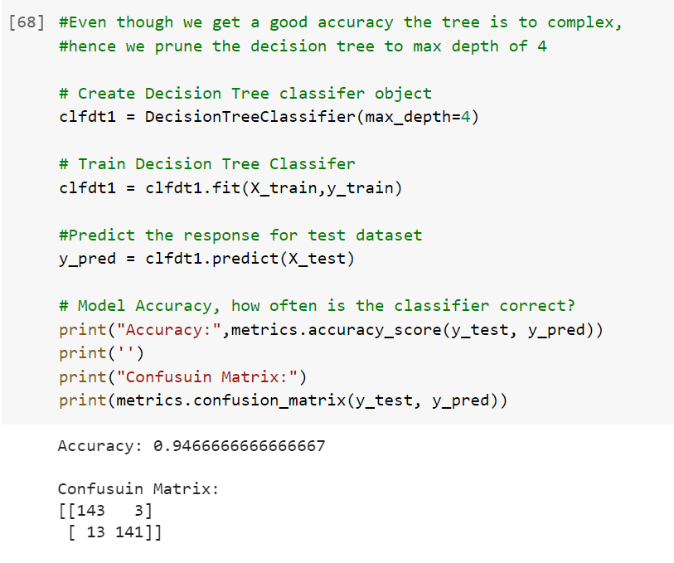
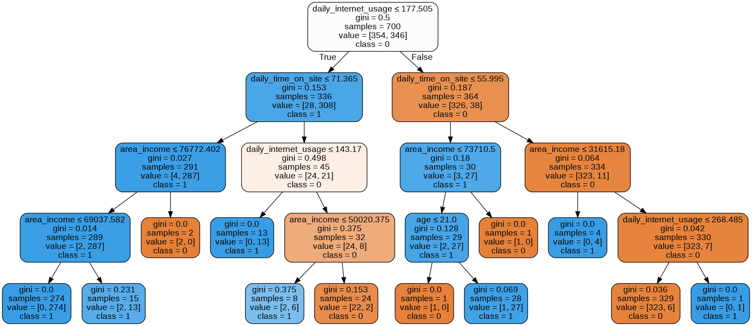
Decision Tree
Most frequent words when Ads not clicked
Most frequent words when Ads clicked
Data
Modelling
Data
Visualization
Summary Statistics
Neural
Network
Data
Cleaning
Naïve
Bayes
Decision
Tree
ROC
SVM
Conclusion
Summary
KNN
Step 3
COLUMN ORDER
ISO CODE

Slide 21
Accuracy – 96.33%
Most frequent words when Ads not clicked
Most frequent words when Ads clicked
Kernel ‘rbf’
Library
Data
Visualization
Summary Statistics
Neural
Network
Data
Cleaning
Naïve
Bayes
Data
Modelling
ROC
KNN
Decision
Tree
Conclusion
Summary
SVM
Kernel ‘Linear’
Step 3
COLUMN ORDER
ISO CODE
SKLEARN SVM
Accuracy – 69.33%

Slide 22
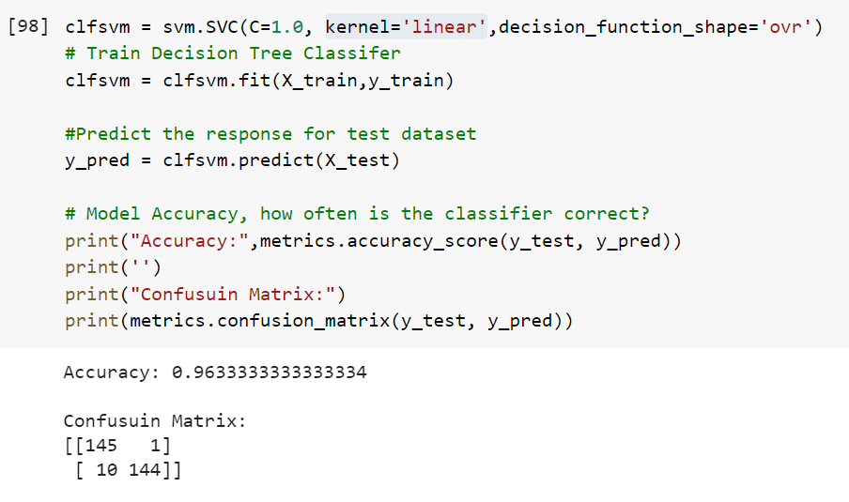
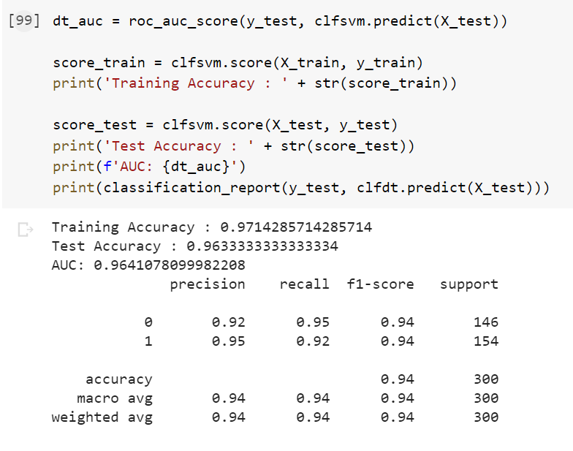
Most frequent words when Ads not clicked
Most frequent words when Ads clicked
Data
Modelling
Data
Visualization
Summary Statistics
Neural
Network
Data
Cleaning
Naïve
Bayes
Decision
Tree
ROC
KNN
SVM
Conclusion
Summary
Step 3
COLUMN ORDER
ISO CODE

Slide 23
Accuracy – 70.66%
Most frequent words when Ads not clicked
Most frequent words when Ads clicked
K=1
Library
Data
Modelling
Data
Visualization
Summary Statistics
Neural
Network
Data
Cleaning
Naïve
Bayes
Decision
Tree
ROC
SVM
Conclusion
Summary
KNN
K =3
Step 3
COLUMN ORDER
ISO CODE
SKLEARN Neighbors Classifier
Accuracy – 74.66%

Slide 24
Accuracy - 96%
Most frequent words when Ads not clicked
Most frequent words when Ads clicked
AUC
Library
Data
Modelling
Data
Visualization
Summary Statistics
Neural
Network
Naïve
Bayes
Decision
Tree
Data
Cleaning
ROC
SVM
Conclusion
Summary
KNN
Soft classification
Step 3
COLUMN ORDER
ISO CODE
SKLEARN Gaussian NB
96.068%

Slide 25
ACCURACY - 89.33%
LOSS – 0.45
Most frequent words when Ads not clicked
Most frequent words when Ads clicked
MULTI-LAYER
PERCEPTRON
Data Split
Data
Modelling
Data
Visualization
Summary Statistics
Neural
Network
Data
Cleaning
Naïve
Bayes
Decision
Tree
ROC
SVM
Conclusion
Summary
KNN
SINGLE LAYER
PERCEPTRON
Step 3
COLUMN ORDER
ISO CODE
70% TRAINING
15% VALIDATION
15% TEST
ACCURACY - 97.33%
LOSS – 0.10

Slide 26
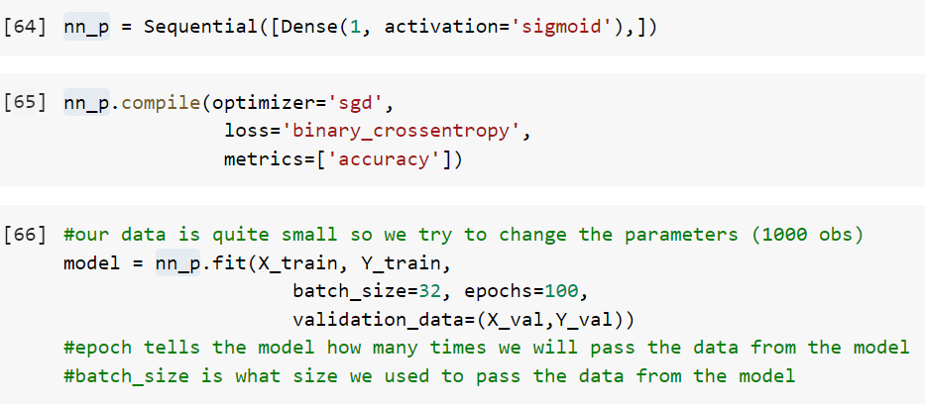
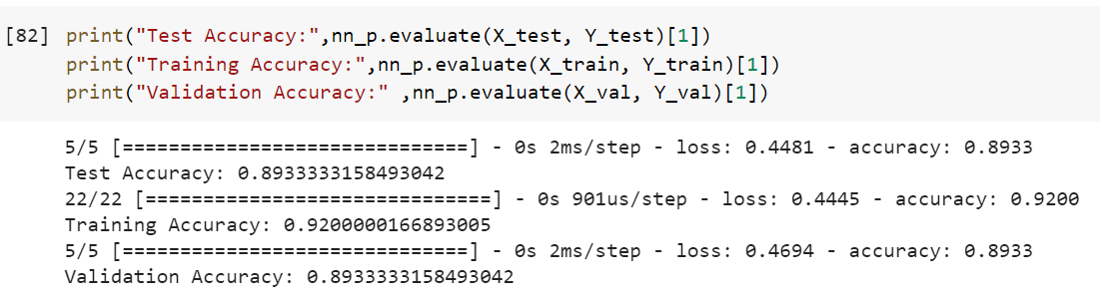
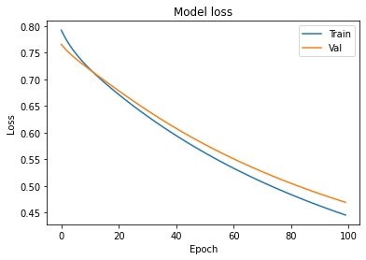
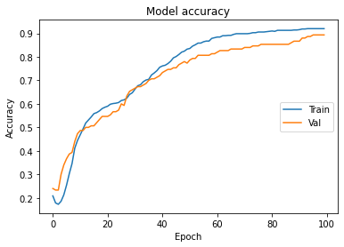
Most frequent words when Ads not clicked
Most frequent words when Ads clicked
Data
Modelling
Data
Visualization
Summary Statistics
Neural
Network
Data
Cleaning
Naïve
Bayes
Decision
Tree
ROC
SVM
Conclusion
Summary
KNN
Step 3
COLUMN ORDER
ISO CODE

Slide 27
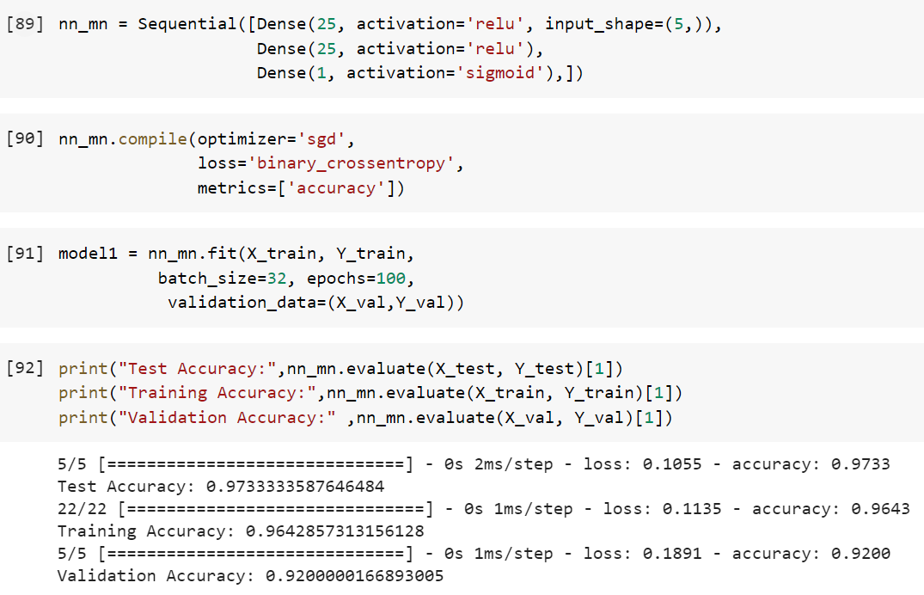
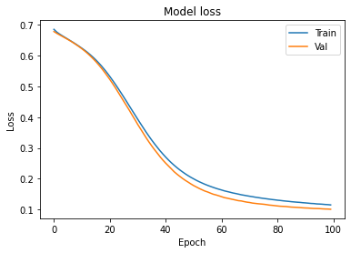
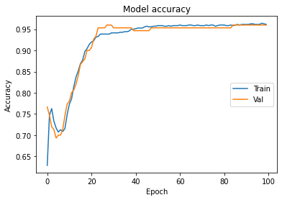
Most frequent words when Ads not clicked
Most frequent words when Ads clicked
Data
Modelling
Data
Visualization
Summary Statistics
Neural
Network
Data
Cleaning
Naïve
Bayes
Decision
Tree
ROC
SVM
Conclusion
Summary
KNN
Step 3
COLUMN ORDER
ISO CODE

Slide 28
Most frequent words when Ads not clicked
Most frequent words when Ads clicked
Data
Modelling
Data
Visualization
Summary Statistics
Neural
Network
Data
Cleaning
Naïve
Bayes
Decision
Tree
ROC
SVM
KNN
Conclusion
Summary
Step 3
COLUMN ORDER
ISO CODE

Slide 29
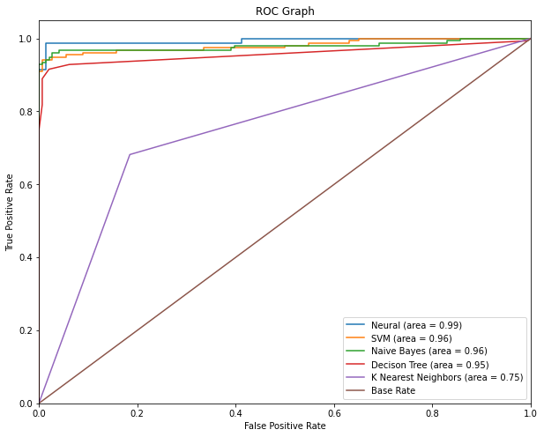
Most frequent words when Ads not clicked
Most frequent words when Ads clicked
Data
Modelling
Data
Visualization
Summary Statistics
Neural
Network
Data
Cleaning
Naïve
Bayes
Decision
Tree
ROC
SVM
KNN
Conclusion
Summary
Step 3
COLUMN ORDER
ISO CODE

Slide 30
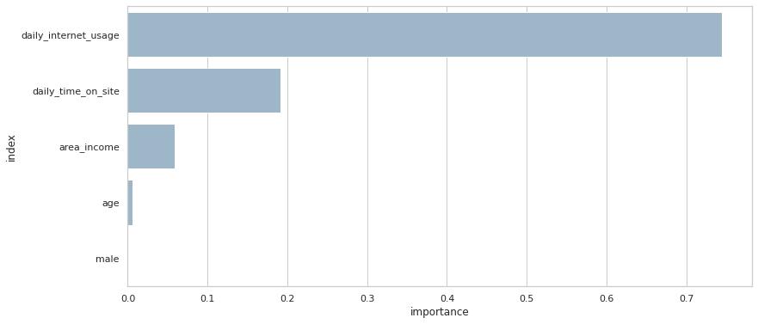
IMPORTANT VARIABLES
Most frequent words when Ads not clicked
Most frequent words when Ads clicked
Data
Modelling
Data
Visualization
Summary Statistics
Neural
Network
Data
Cleaning
Naïve
Bayes
Decision
Tree
ROC
SVM
KNN
Summary
Conclusion
Step 3
COLUMN ORDER
ISO CODE

Slide 31
NOT RELEVANT ADS
Most frequent words when Ads not clicked
Most frequent words when Ads clicked
20 to 40 AGE
More than 60 mins onsite
POTENTIAL
50% OF VISITORS
Data
Modelling
Data
Visualization
Summary Statistics
Neural
Network
Data
Cleaning
Naïve
Bayes
Decision
Tree
ROC
SVM
KNN
Summary
Conclusion
Step 3
COLUMN ORDER
ISO CODE
TARGET
INCOME LESS THAN $40,000
TIME ON SITE LESS THAN 80 MINS
TIME ON INTERNET LESS THAN 200 MINS
LIMITATION
TYPE OF SITE
AD TYPE

Slide 32
THANK YOU
REPORT SUBMITTED CODE FILE ATTACHED
Data
Modelling
Data
Visualization
Summary Statistics
Neural
Network
Data
Cleaning
Naïve
Bayes
Decision
Tree
ROC
SVM
KNN
Summary
Conclusion
Step 3
COLUMN ORDER
ISO CODE

